Slide 1
Design & Implementation of Rogue AP Detection System in Wi-Fi Networks
Student: Zhenyu Wu & Qizhen Weng
Mentor: Prof. Cunqing Hua

Slide 2
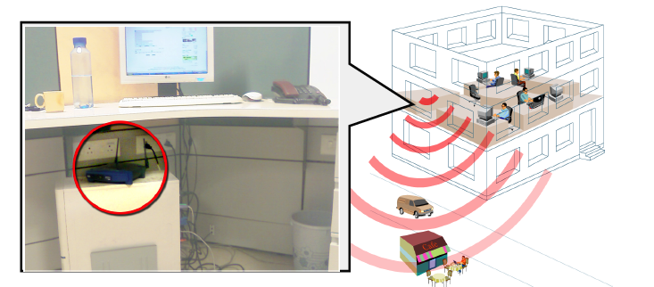
An example of rogue AP in commodity network

Slide 3
Taxonomy of Rogue AP^{[1]}
Rogue AP Class | Possible Scenarios
Improperly configured | Insufficient security knowledge
Unauthorized | Connected to internal LAN without permission; external neighborhood AP
Phishing | Fabricated by adversary
Compromised | Disclosure of security credentials

Slide 4
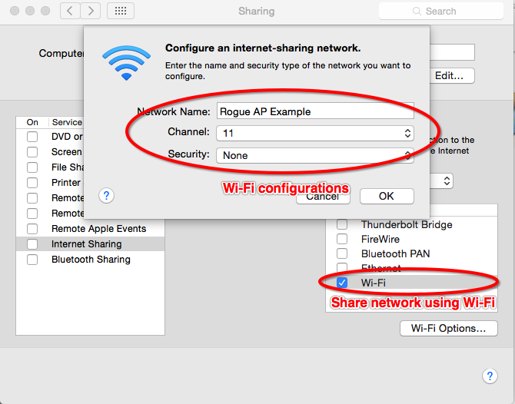
Example of Building a Rogue AP
Built with one wired NIC bridged to another wireless NIC
using Network Sharing on Mac

Slide 5

Threats of Rogue AP
Sniffer & Monitor
Man in Middle Attack
Flood of Denial of Service

Slide 6
Investigation on Existing Solution
A Measurement Based Rogue AP Detection Scheme^{[3]}
A Timing-Based Scheme for Rogue AP Detection^{[2]}
Passive Online Rogue Access Point Detection Using Sequential Hypothesis Testing with TCP ACK-Pairs^{[4]}
Rogue Access Point Detection using Temporal Traffic Characteristics^{[5]}

Slide 7










Timing-Based Scheme^{[2][3]}

Slide 8
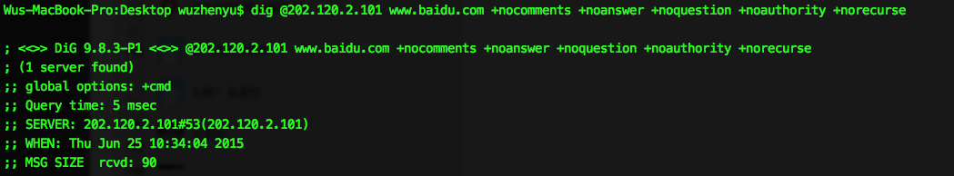
DNS Lookup Implementation
A nonrecursive request to local DNS server for a host name
Repeat this process with a different host name each time
Use dig command in Linux/Unix
dig [@dnsServer] [-f filename] [-t type] +[no]QueryOptions
See DNSLookup.py

Slide 9
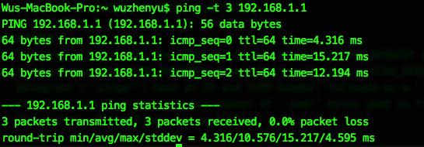
AP Probe Implementation
A unicast message by putting the target AP’s MAC address to the destination field of the probe request
Use duration to estimate the channel traffic and AP’s workload
Difficult for rogue AP to replicate a busy channel
ping [-t timeout] @AP
Use ping command to probe???
Needs investigation

Slide 10
Linux Commands on Android
Linux/Unix commands like dig, traceroute, ping
Java doesn’t support low-level programming to capture ICMP packets
Failed with current Android API
Import 3rd party library or use rooted device?
Use BusyBox utility? (Works for Ping & Traceroute, but Dig failed)
Find tools or 3rd party libs to support
low-level Linux command on Android

Slide 11
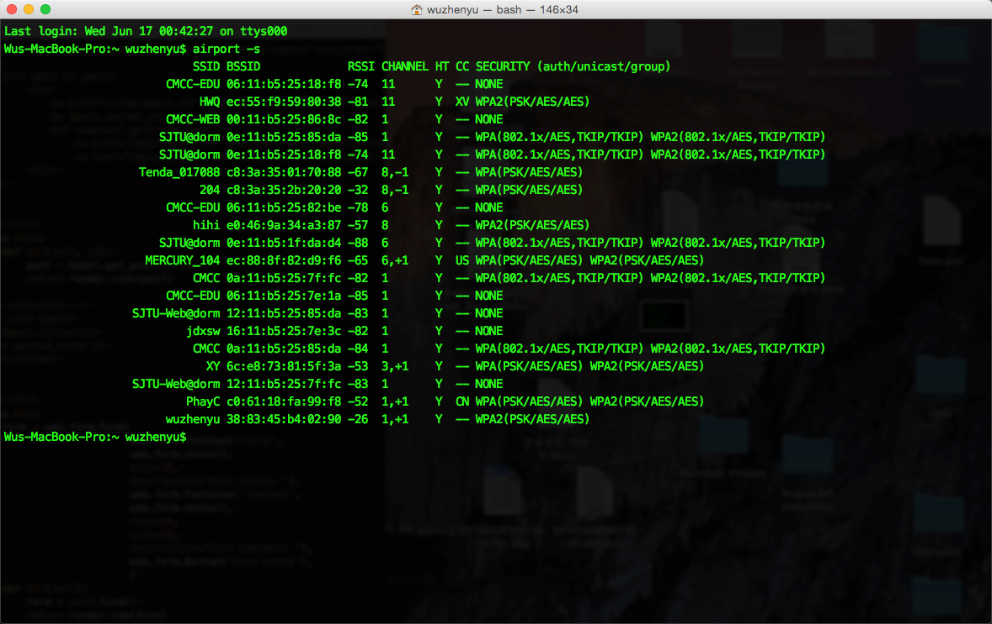
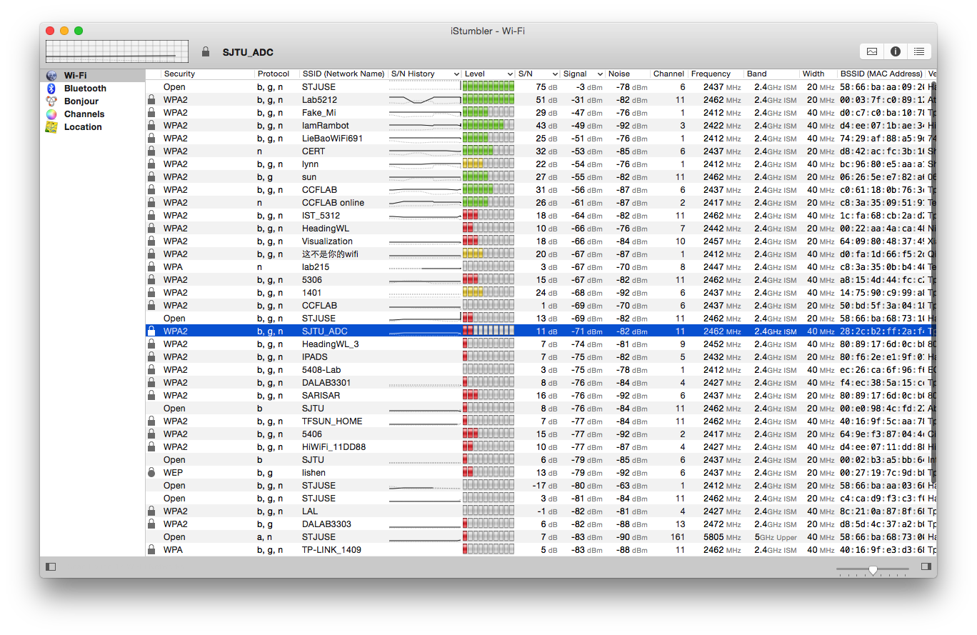
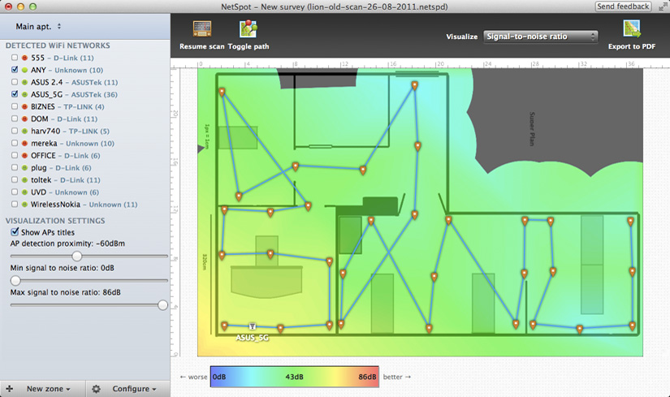
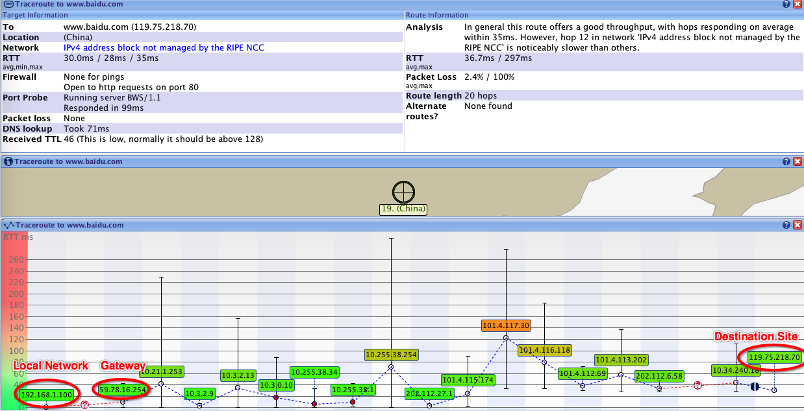
Collection of Tools
Airport Utility
iStumbler
NetSpot
VisualRoute
These tools works on Mac, only help us research

Slide 12
Design of the Detection System
Client
  Collect APs’ Features (BSSID, Encryption, Route, Vendor, Channel, Location, RTT Samples…)
  Update Authorized APs’ Features
  Send all above to the server
Server
  Analyze the received APs’ Features
  Compute Credit associated with each AP
  Store APs’ Features and Credits in the database
  Receive data from the Client

Slide 13
Database (Continued)
Users
Username | Password
AuthorizedAPs
BSSID | SSID | Channel | Vendor | Location | Route
APsFeatures
BSSID | SSID | Channel | Vendor | Location | Security | Signal | Noise | route
APsCredit
BSSID | IsAuthorized | UserAccessHistory | Security | Route | RTTeval | Credit
RTTEvaluation
BSSID | RTTprobeList | RTTdnsList | MeanProbe | MeanDns | DevProbe | DevDns | RTTeval
See init.sql & dbOperations.py

Slide 14
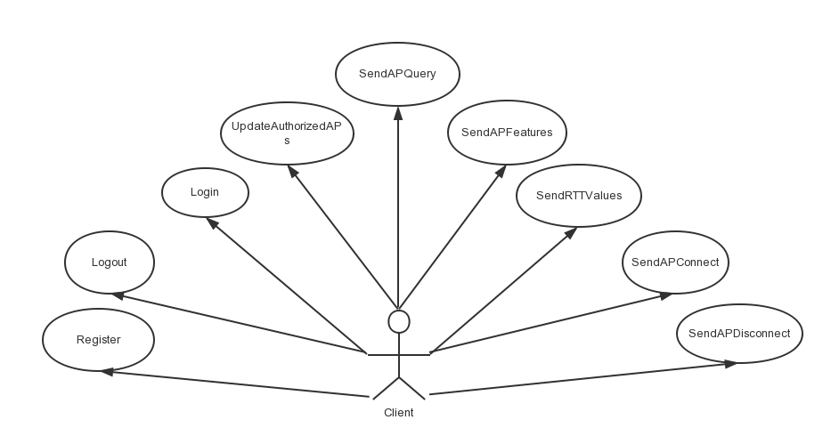
Implementation of the Server
User Case Graph

Slide 15
Continued
Web.py framework
Session
URL Handler
Post & Get
See detectionServer.py

Slide 16
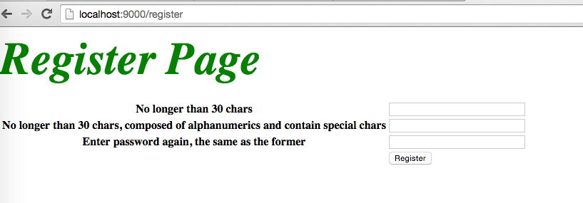
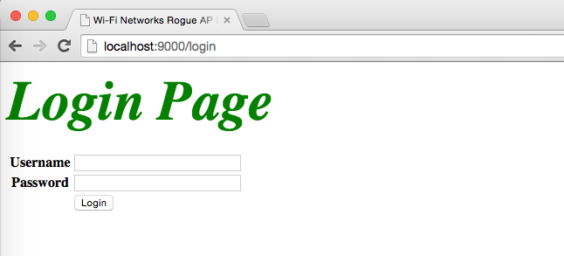
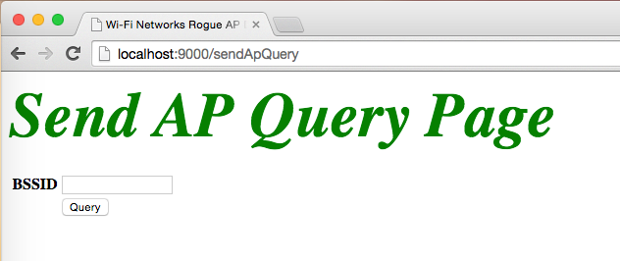
Running Screenshots
Pic 1. Register Page
Pic 2. Login Page
Pic 3. AP Query Page

Slide 17
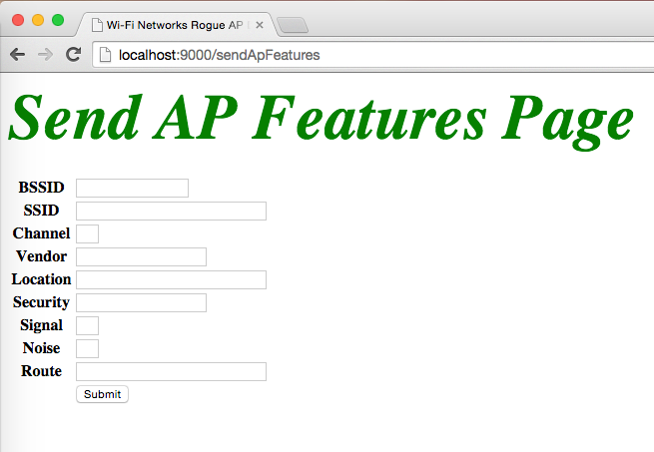
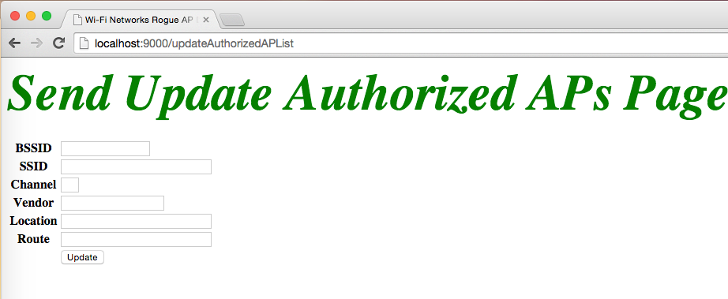
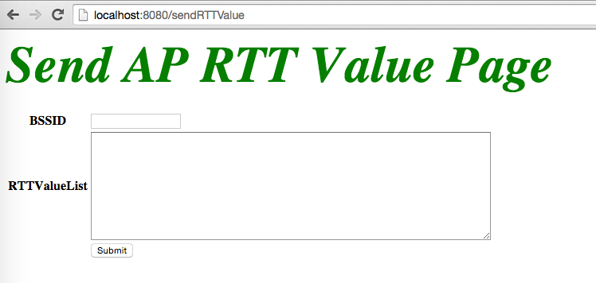
Continued
Pic 4. Send AP Features Page
Pic 5. Send AP Features Page
Pic 6. Send AP RTT Samples Page

Slide 18
Implementation of Client
Android
Httpclient
WifiManager
ScanResult
BSSID, SSID, Level, Capability, Frequency…
Use Busybox utility to simulate Linux environment on Android (for commands like Traceroute, Ping, Dig…)
See detectionClient Android project

Slide 19
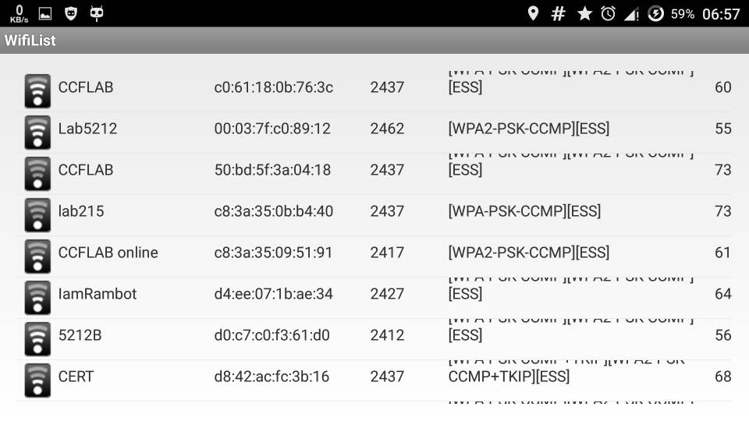
Running Screenshots
Show SSID, BSSID, Frequency, Security and Level in ListView on Android

Slide 20

Demo

Slide 21
Future Work
Implement Communication between Android Client and Python Server (Use HttpClient?) (See Slide #12)
Further investigation on the timing-based scheme, about the threshold value (See Slide #7)
Implement traceroute, dig and probe command on Android (Use Busybox or 3rd party library?)
Implement Credit computation algorithm on Server
Improve SQL in database manipulation

Slide 22
References
[1] Liran Ma, Amin Y. Teymorian, Xiuzhen Cheng. “A Hybrid Rogue Access Point Protection Framework for Commodity Wi-Fi Networks”. In the IEEE INFOCOM 2008 proceedings.
[2] Hao Han, Bo Sheng, Chiu C. Tan, Qun Li and Sanglu Lu. “A Timing-Based Scheme for Rogue AP Detection”. IEEE TRANSACTIONS ON PARALLEL AND DISTRIBUTED SYSTEMS, VOL. 22, NO. 11, NOVEMBER 2011.
[3] Hao Han, Bo Sheng, Chiu C. Tan, Qun Li and Sanglu Lu. “A Measurement Based Rogue AP Detection Scheme”.In the IEEE INFOCOM 2009 proceedings.
[4] Wei Wei, Kyoungwon Suh, Bing Wang, Yu Gu, Jim Kurose, Don Towsley. “Passive Online Rogue Access Point Detection Using Sequential Hypothesis Tesing with TCP ACK-pairs”.
[5] Raheem Beyah, Shantanu Kangude, George Yu. “Rogue Access Point Detection using Temporal Traffic Characteristics”.

Slide 23
Q&A

